Slide 1
Computer Networks
Performance
S.V.Jansi Rani
Associate Professor / CSE

Slide 2
Agenda
Bandwidth
Throughput
Latency
Jitter
Test Your Understanding

Slide 3



Slide 4
Performance
Bandwidth in Hertz
Bandwidth in hertz is the range of frequencies contained
in a composite signal or the range of frequencies a channel can pass. For example,
bandwidth of a subscriber telephone line is 4 kHz.
Bandwidth in Bits per Seconds
The term bandwidth can also refer to the number of bits per second that a channel, a link, or even a network can transmit. For example,
Bandwidth of a Fast Ethernet network (or the links in this network) is a maximum of 100 Mbps. This means
that this network can send 100 Mbps.
Relationship
An increase in bandwidth in hertz means an increase in bandwidth in bits per second

Slide 5
Throughput
The throughput is a measure of how fast we can actually send data through a network.
Bandwidth in bits per second and throughput –not same
A link -B bps BW ,T throughput where T<B.
BW- potential measurement of a link
Th - actual measurement of how fast we can send data.
Eg: Link -1 Mbps, device handle only 150kbps.
Eg: Highway - transmit 1000 cars per minute from one point to another. Due to congestion 100 cars per minute. BW- 1000 cars per minute, Th - 100 cars per minute.

Slide 6
Example -Throughput
Network with bandwidth of 10 Mbps can pass only an average of 12,000 frames per minute with each frame carrying an average of 10,000 bits. What is the throughput of this network?
Throughput = (12,000 * 10,000) / 60

Slide 7
Example -Throughput
Network with bandwidth of 10 Mbps can pass only an average of 12,000 frames per minute with each frame carrying an average of 10,000 bits. What is the throughput of this network?
Throughput = (12,000 * 10,000) / 60 = 2 Mbps

Slide 8
Latency / Delay
How long it takes for an entire message to completely arrive at the destination from the time the first bit is sent out from the source.
Latency = propagation time + transmission time +
queuing time + processing delay

Slide 9
Propagation time measures the time required for a bit to travel from the source to the destination.
Propagation time = Distance / (Propagation Speed)
The propagation speed - medium and on the frequency of the signal.
For example, in a vacuum, light is propagated with a speed
of 3 × 10⁸ m/s. It is lower in air; it is much lower in cable.

Slide 10

Example
What is the propagation time if the distance between the two points is 12,000 km? Assume the propagation speed to be 2.4 × 10⁸ m/s in cable.

Slide 11
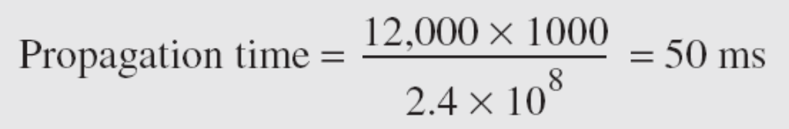
Example
What is the propagation time if the distance between the two points is 12,000 km? Assume the propagation speed to be 2.4 × 10⁸ m/s in cable.

Slide 12
Transmission Time
The first bit may take a time equal to the propagation time to reach its destination; the last bit also may take the same amount of time.
There is time between the first bit leaving the sender and the last bit arriving at the receiver.
TT - size of the message and the bandwidth of the channel.
Transmission time = (Message size) / Bandwidth

Slide 13
What are the propagation time and the transmission time for a 2.5-KB (kilobyte) message (an email) if the bandwidth of the network is 1 Gbps? Assume that the distance between the sender and the receiver is 12,000 km and that light travels at 2.4 × 10⁸ m/s.

Slide 14


What are the propagation time and the transmission time for a 2.5-KB (kilobyte) message (an email) if the bandwidth of the network is 1 Gbps? Assume that the distance between the sender and the receiver is 12,000 km and that light travels at 2.4 × 10⁸ m/s.

Slide 15

What are the propagation time and the transmission time for a 2.5-KB (kilobyte) message (an email) if the bandwidth of the network is 1 Gbps? Assume that the distance between the sender and the receiver is 12,000 km and that light travels at 2.4 × 10⁸ m/s.

Slide 16
What are the propagation time and the transmission time for a 5-MB (megabyte) message (an image) if the bandwidth of the network is 1 Mbps? Assume that the distance between the sender and the receiver is 12,000 km and that light travels at 2.4 × 10⁸ m/s.

Slide 17



Slide 18


Slide 19
Queuing Time
The third component in latency is the queuing time, the time needed for each intermediate or end device to hold the message before it can be processed.
The queuing time is not a fixed factor; it changes with the load imposed on the network.
When there is heavy traffic on the network, the queuing time increases.
An intermediate device, such as a router, queues the arrived messages and processes them one by one.
If there are many messages, each message will have to wait.

Slide 20

Bandwidth Delay Product (BDP)
The bandwidth-delay product defines the number of bits that can fill the link

Slide 21
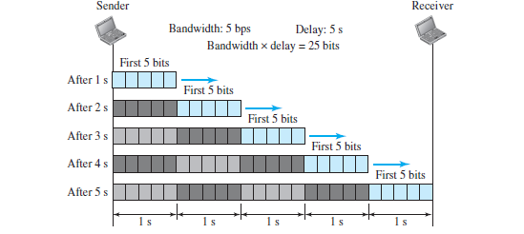

Slide 22


Slide 23
Jitter
Jitter is a problem if different packets of data encounter different delays and the application using the data at the receiver site is time-sensitive (audio and video data).
If the delay for the first packet is 20 ms, for the second is 45 ms, and for the third is 40 ms, then the real-time application that uses the packets endures jitter.

Slide 24


Slide 25
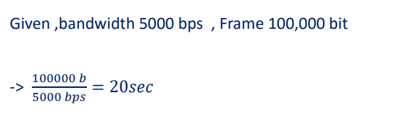

Slide 27
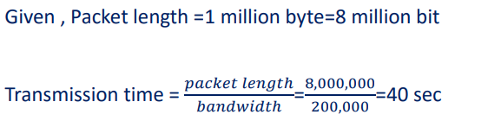

Slide 29
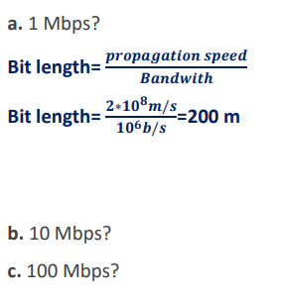

Slide 30
Test Your Understanding

Slide 31
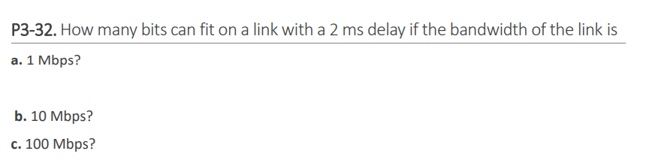

Slide 32
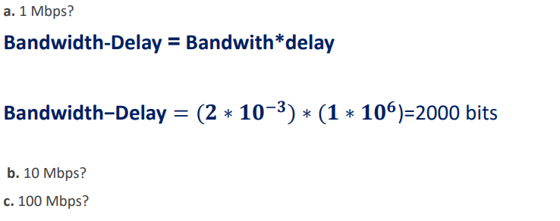

Slide 33
THANK YOU

